Slide 1

Edgefield-McCormick Adult Education and Family Literacy
A great place to start!

Slide 2






COVID19: Daily Wellness Procedures
Masks
01
Must be worn upon entry
Temperature (Daily)
02
Temperature tracking and must not exceed 100. 4
Sanitization
04
Frequent and routine cleaning of surface areas
COVID19 Screening
03
Daily questions

Slide 3
Admission Requirements
Must be 17 years old or older
Under 18, but at least 16, must have board approval
Valid License or SC Identification
Under 18, Verification of withdrawal
Transcripts
High School Diploma
GED
WIN
WorkKeys
Career Pathway
Manufacturing
Literacy

Slide 4

Please complete the following registration survey
ttps://docs.google.com/forms/d/e/1FAIpQLSfFojghUnlblskxmCkXPe8LoEK6Pwufy_juz_zRGYZmyGBuOA/viewform?vc=0&c=0&w=1&flr=0

Slide 5
Edgefield County Adult Education and Family Literacy
Adult Education Mission Statement
Our mission is to create a caring and safe environment that emphasizes high achievement and career preparation for all students by providing quality educational opportunities to meet the needs of our adult community.
Family Literacy Mission- is to equip families with the academics, parenting, and career readiness skills needed to ensure that both parent and child are prepared for success in school and their future careers.
Guiding Principles
Empowers- Edgefield-McCormick Adult Education and Family Literacy believes that learning is a lifelong process that empowers students, regardless of their cultural background, the right to an education in order to become independent responsible citizens capable of reaching their fullest potential.
Enriches- Edgefield-McCormick Adult Education and Family Literacy believes that all students learn best in a safe, nurturing environment where respect for self, others and property, learning permeates and enriches their well-being.
Engages- Edgefield-McCormick Adult Education and Family Literacy believes that parents are their child’s first teacher and advocates for parents to become full partners who are engaged in the educational development of their children.

Slide 6
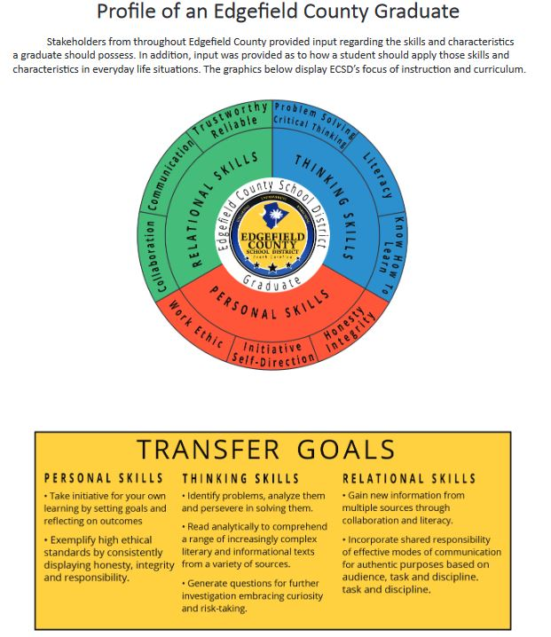
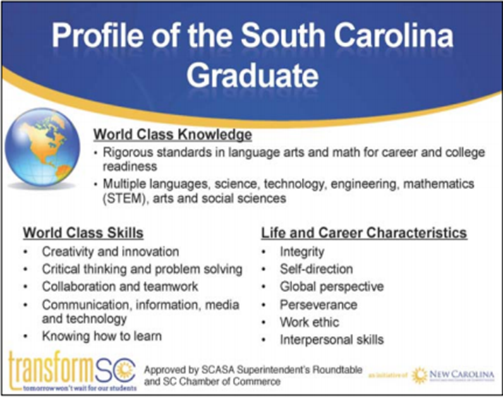
Preparing students for the FUTURE!
All graduates must have transferrable skills for the
World of work and postsecondary education
All students must be prepared for college or career

Slide 7
Registration and Orientation Dates
Requirements:
Registration & Orientation are required before attending
TABE Pre-Assessment
Complete and Sign all documents
Login to Online Accounts

Slide 8

Testing Schedule:
Monday | Tuesday | Wednesday | Thursday | Friday
New Student Orientation | TABE Assessment/ Registration (Please refer to schedule) Post-Testing | WIN Testing 9:00am-4:00pm Post-Testing | GED Testing 12:00-4:00pm (adult education students only) | GED Testing 9:00am -4:00pm

Slide 9
Free GED
RLA
(Reasoning through Language Arts)
150 minutes
Math
(Mathematical Reasoning)
115 minutes
Science
90 minutes
Social Studies
70 minutes
Before we Pay:
Create an Account @ www.ged.com
Have a current state issued ID
Take the GED READY
Pass the GED READY with A 150 or better
Schedule to take GED Exam(s)
Below Passing | Passing/High School Equivalency | GED College Ready | GED College Ready + Credit
100-144 | 145-164 | 165-174 | 175-200

Slide 10
High School Diploma
Units of Credit
English 4 | US History 1
Math 4 | Economics 1/2 | Electives 9
Science 3 | Government 1/2
Other Social Studies 1 | Computer Science 1
Disclaimer
Students must have at least 18 units of credit to apply for the High School Diploma Program. Students cannot take more than 6 units of credit for the Year
The following courses require an End-of-Course Assessment to receive course credit:
1.) Algebra1
2.) English 1
3.) Physical Science
4.) Biology
5.) US History and Constitution

Slide 11
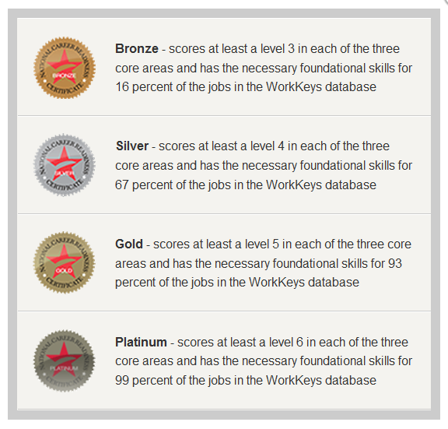
The WIN/WorkKeys
The Career Readiness Certificate Program is a process for developing and documenting universally recognized workplace skills.
Areas required by most employers:
WorkPlace Documents
Applied Mathematics
Graphic Literacy
Locating Information (WIN)
Reading for Information (WIN)

Slide 12
Rules are to keep us Safe and Learning
Please refrain from the following:
Dress Code
Dress to Impress
NO Pajamas or Slippers
No Mid-Sections or low-cut blouses
No Promotion of Drug Use
Pants must be pulled up at all times
No bonnets or headscarves
Damaging Property
Abusing or threatening Others
Carrying a Weapon
Using Drugs
Bomb Threats
Endangering Others
Cheating on Tests
Leaving Campus before dismissal

Slide 13


No Profanity or Cursing
Leaving Campus requires students to sign-out.

Slide 14



Cell Phone Policy
Cell Phones should be on Vibrate
Step outside of classroom and away from class to answer emergencies calls
Cell Phones should not be
Out during class
During testing and LAB Use, phones should be stored

Slide 15
Attendance Policy
ABSENCES
3 unexcused absences per session
Dismissed from program
Must re-enroll
Pay enrollment fee
Johnston Learning Center (Mon-Thurs.)
Classes begin at 9am
9:15- Tardy and must not enter the classroom until after scheduled break
Fox Creek (Monday & Tuesday) – Complete 4 t0 6hrs. Weekly
Remote Learning
Laura Grove (Tues- Thursday) Complete 4 t0 6hrs. Weekly
Remote Learning
3 tardies equal 1 absence
Excused Absences
The following is a list of absences that will be excused:
Death in the family not to exceed (3) class meetings.
Recognized religious holidays regularly attended by persons of that faith.
Absences excused by the Director/Office staff prior to their occurrence. School sponsored activities.

Slide 16

Remote Classes
Make sure your internet works
Before you leave, check your username and password works
Keep up with your work
Complete all assignments
Log in 1hr per day
Email your teacher if you have questions

Slide 17
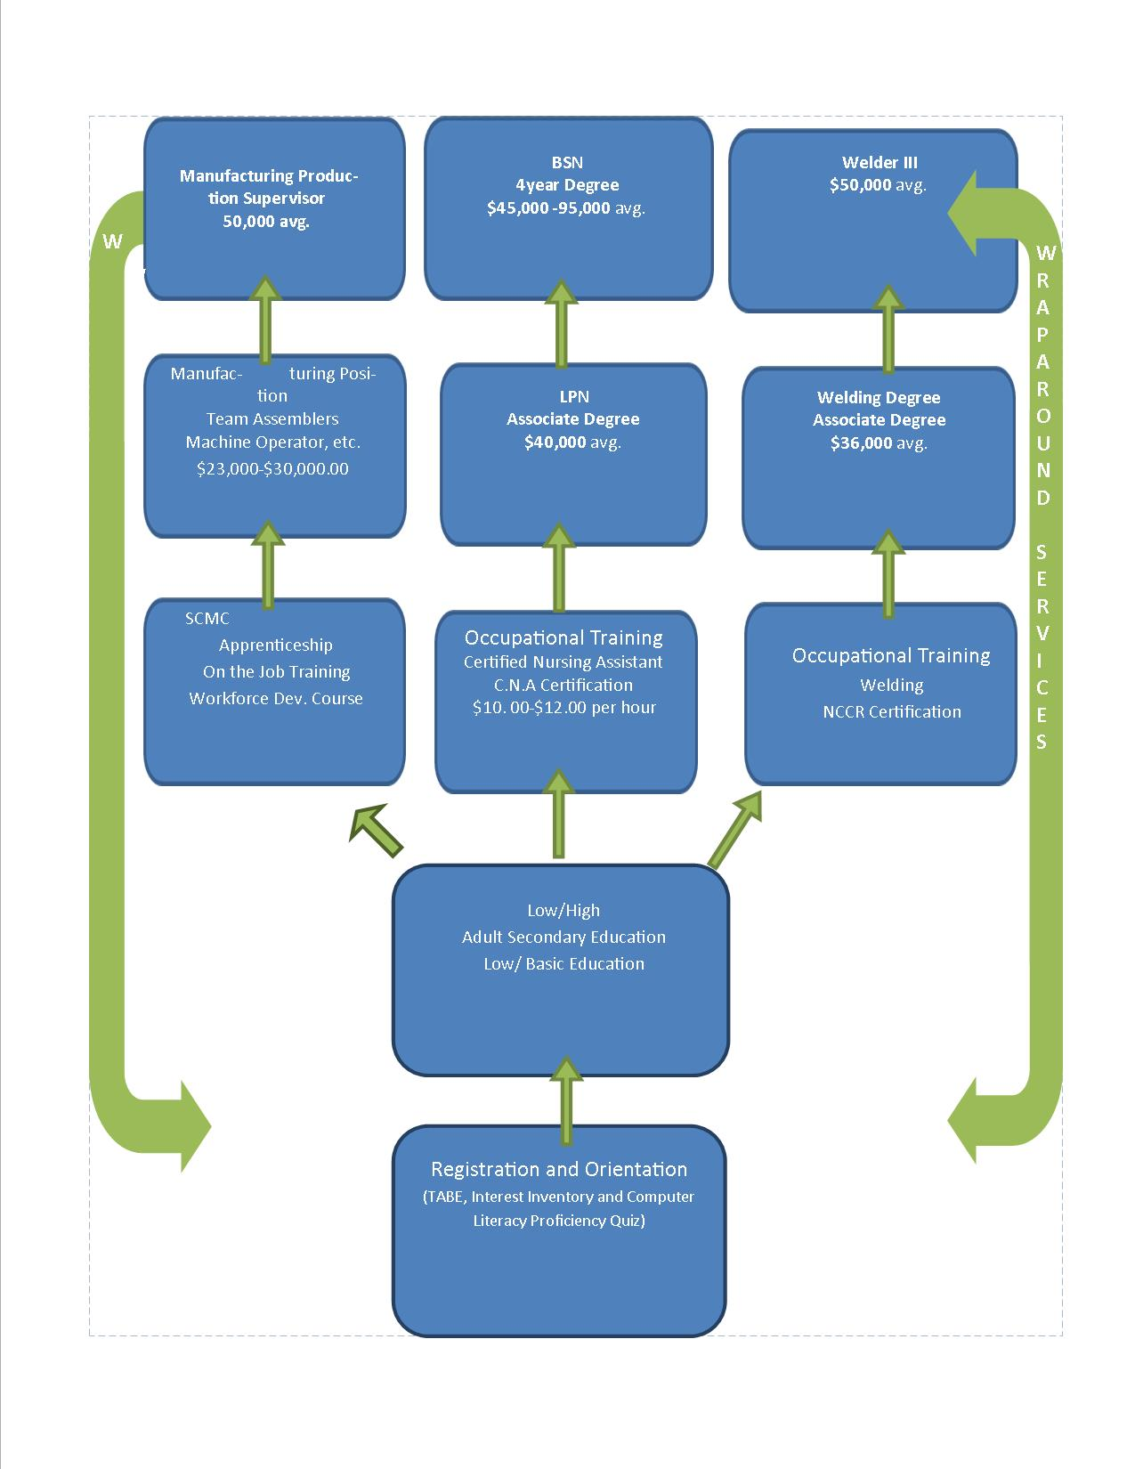
Career Pathways
The purpose of Career Pathways to provide a path to workforce training that will advance the student’s skills and career over a period of time. The Pathway considers the specific training and skill gains needed to advance into both the workplace and the next level of education.
The career pathway involves a series of steps which include:
Career Inventory
Workplace Readiness Certification
Career Portfolio/ Resume
Soft Skills Training
Transitional Services

Slide 18

https://www.mynextmove.org/explore/ip
Explore your Career Interest

Slide 19
Edgefield County Adult Education and Family Literacy Center Procedures
Students must adhere to the COVID Guidelines
All students must to sign-in and out while attending
Students should only park in the designated area
Students are expected to follow classroom rules
Students should not disrupt other classrooms, especially childcare room
Student should report all should suspicious activities or issues of concern
Remote students should login to accounts 4 to 6 hours weekly
All guests must sign-in in the front office and wait in the lobby for escort
Visitors are not allowed on the premises without consent

Slide 20
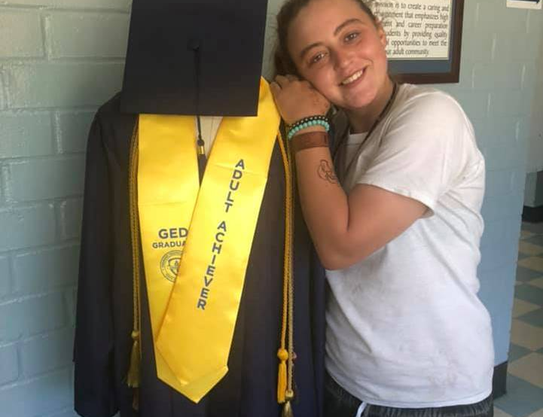
Picture Yourself in a cap and gown!

Slide 21
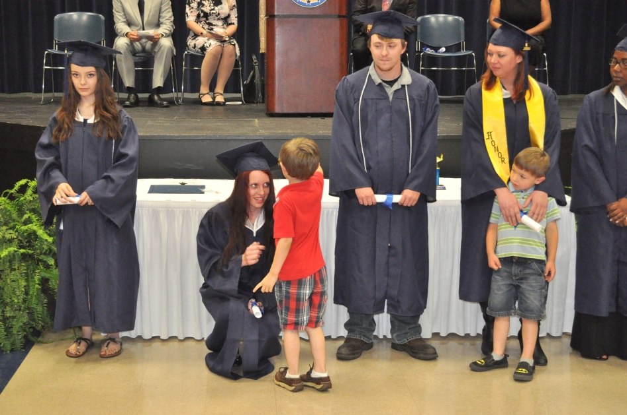
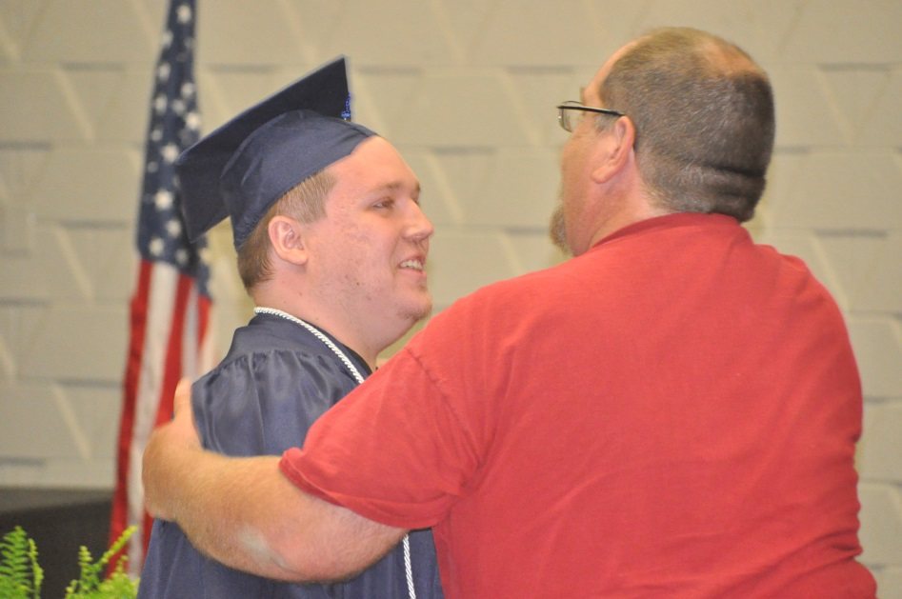
Success can’t Wait
I am getting closer to my dreams every day-
I always knew I could do it; it was matter of how was going to do it- Cole Smith

Slide 22
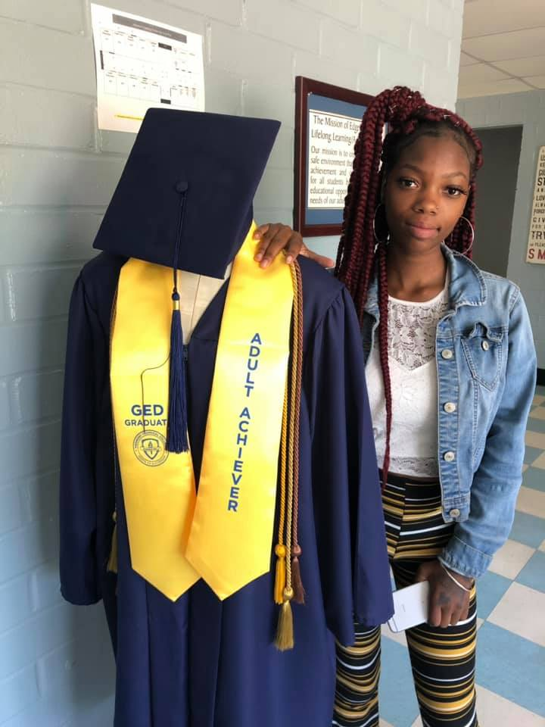
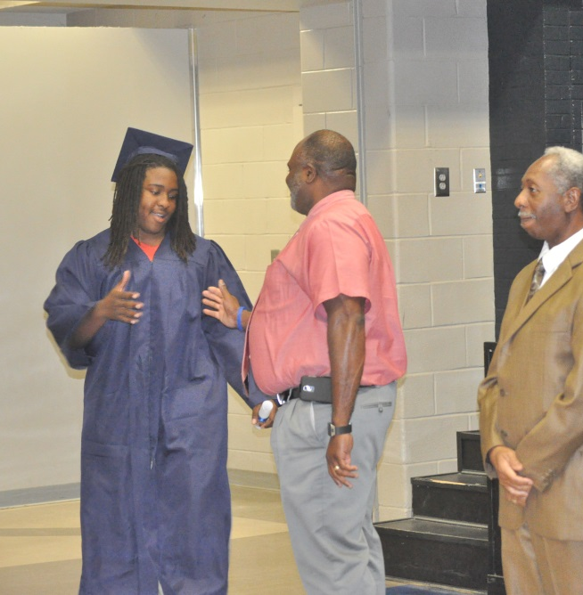
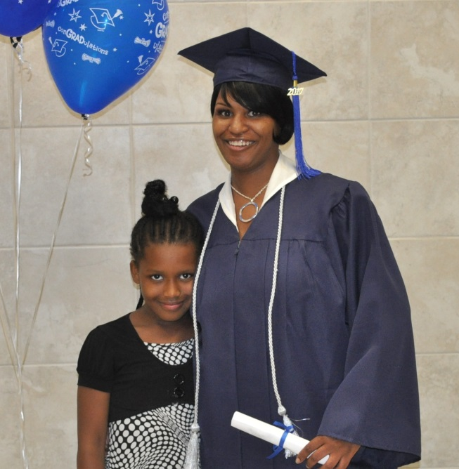
Our Students are the best!
I am grateful for this program. I graduated just a couple months. You can too!!
People gave up on me, but I never did! – Deontravious Rouse
It took a long time, but I finally did it- Aisha Ingram

Slide 23
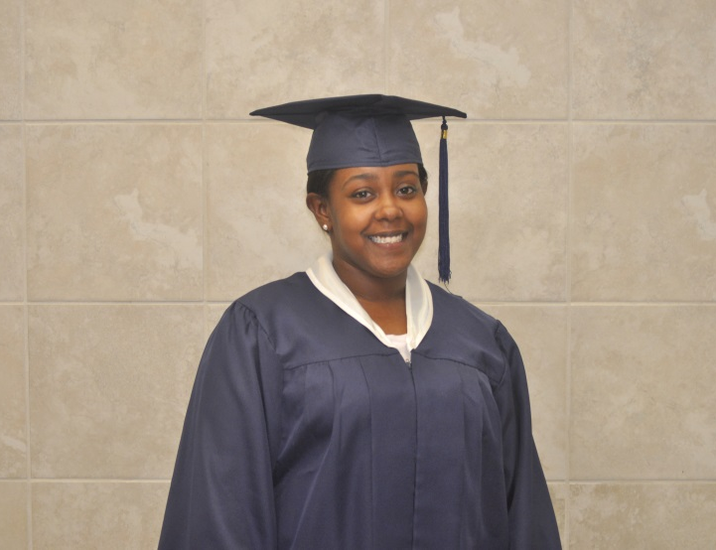
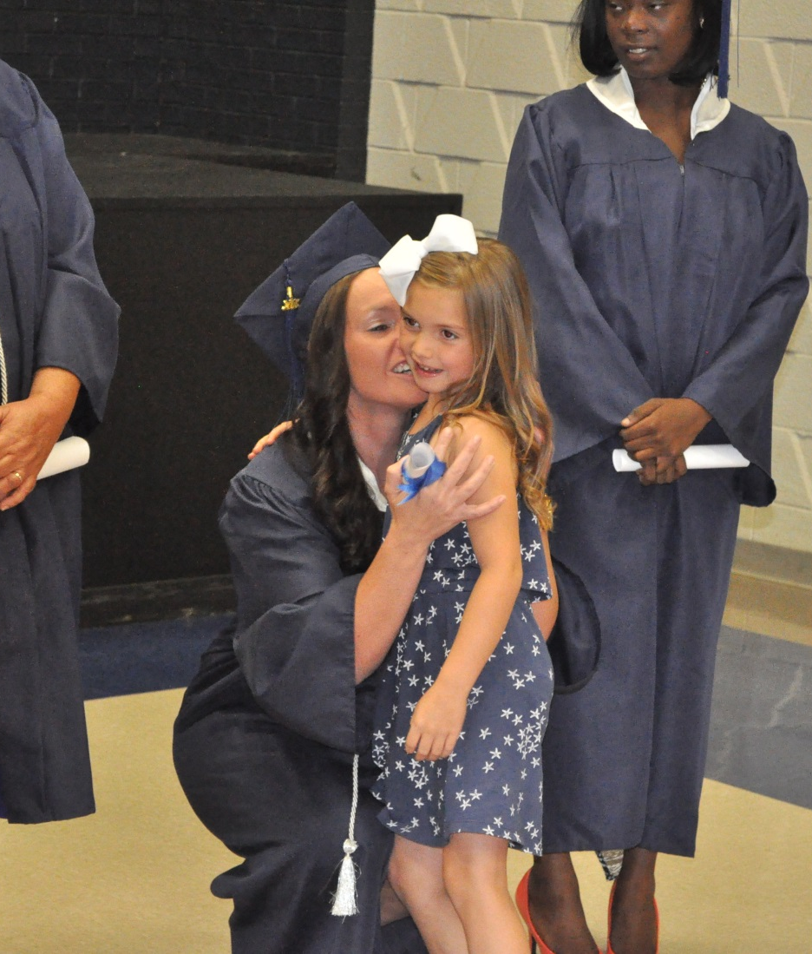
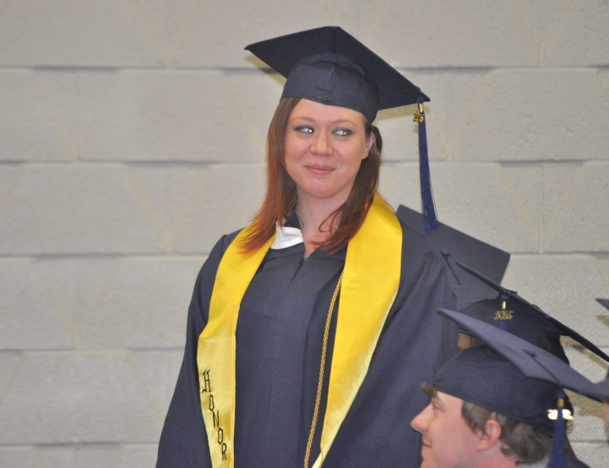
Graduation is
May 27, 2021

Slide 24


